Slide 1

Presented by: Rayshon L, Jaden H, Craig K
CTEC 302

Slide 2
Exxon Mobil Overview
Location(s): Exxon Mobil’s headquarters reside in Irving, Texas. There are operations in more than 60 countries.
Exxon is a multinational oil and gas company that discovers, produces, and delivers energy and chemicals to customers around the world. Exxon has a decentralized structure which allows the company to divide itself intro several business segments each with their own leadership.
Number of Offices: 62
ExxonMobil distributes and provides to a wide and diverse range of clientele, including industrial, commercial, and retail customers. Their services include fuel supply, lubricant, and petrochemical products.
Employees: There are over 61,000 employees (Last Reported 12/31/2024). Employees are spread across various global locations, including offices, refineries, and production facilities.
Clients: Large industry clients in sectors such as manufacturing, transportation, and energy who rely on ExxonMobil’s products and services. Consumers purchasing ExxonMobil fuel and lubricants through retail outlets are a large portion of sales. Clients are located worldwide which benefits the ExxonMobil’s chemical products for manufacturing and production.
Stakeholders: The backbone of the company are the employees, as it contributes vastly to Exxon’s operations and success. Key decision makers and leaders drive the company’s strategic direction. The stakeholders includes individuals and institutional investors who own shares in ExxonMobil, including major stakeholders like Vanguard.

Slide 3

Roles in Exxon
ExxonMobil employs thousands of individuals worldwide, including engineers, scientists, and business professionals. The company is structured into upstream, downstream, and chemical divisions, each focusing on specific aspects of the energy and chemical industries. Roles vary in different fields including engineering, research, operations and finance.

Slide 4
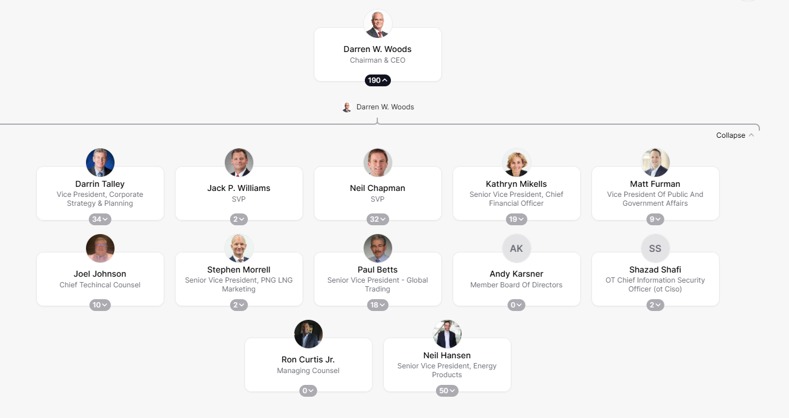
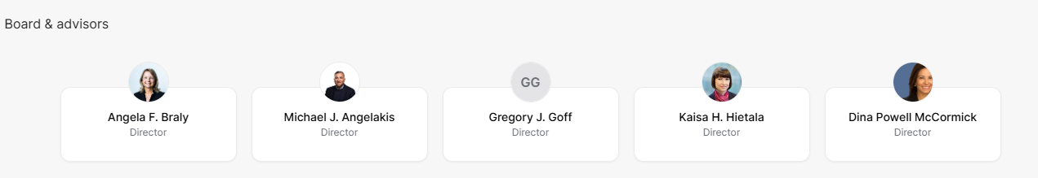
Positions in Exxon Management

Slide 5
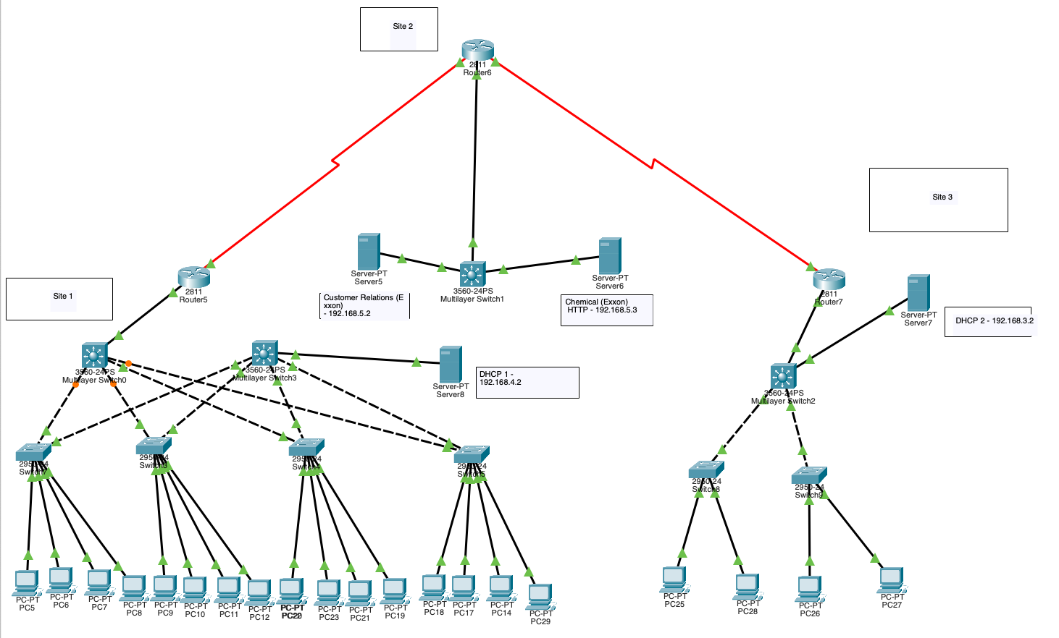

Slide 6
Resources
Put into APA Format
ExxonMobil Headquarters + 44 Office locations Updated 2025
ExxonMobil Corporate Headquarters, Office Locations and Addresses | Craft.co
​Management Committee | ExxonMobil
Exxon: Number of Employees 2010-2024 | XOM | MacroTrends

